Slide 1
Machine Learning for the Efficient Control
of a Multi-Wheeled Mobile Robot
Anton Kabysh
BrSTU-Robotics laboratory
Brest State Technical university

Slide 2
Goals of research
1/41
Efficient control system for a multi-wheeled production robot
System must easy adapt for wheels reconfiguration
Robust and accurate control
High mobility of the robot movement

Slide 3
Efficient robot control
2/41
Accurate and robust control
Path planning optimization
Power consumption optimization.

Slide 4
Problem
3/41
A robot may have many wheels

Slide 5
Problem
4/41
Many many wheels…..

Slide 6
Problem
5/41
A robot may have many wheels
Platform needs high manoeuvrability

Slide 7
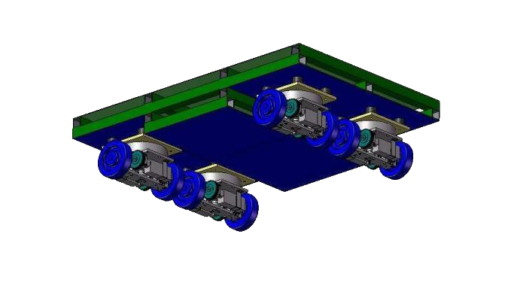
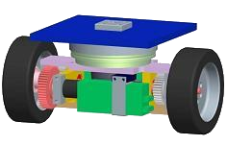
Problems
6/41
A robot may have many wheels
Platform needs high manoeuvrability
Each wheel controls independently

Slide 8
Proposed approach
7/41
Multi-agent reinforcement learning

Slide 9
Proposed approach
8/41
Multi-agent reinforcement learning
Improved multi-agent learning

Slide 10
Proposed approach
9/41
Multi-agent reinforcement learning
Improved multi-agent learning
Platform decomposition approach

Slide 11
Proposed approach
10/41
Multi-agent reinforcement learning
Improved multi-agent learning
Platform decomposition approach
Control optimization by reward function

Slide 12
Proposed approach
11/41
Multi-agent reinforcement learning
Improved multi-agent learning
Platform decomposition approach
Control optimization by reward function
Generalization of agents for improving mobility

Slide 13
Scientific novelty
12/41
Multi-agent Reinforcement learning framework
new agents study approach

Slide 14
Scientific novelty
13/41
Multi-agent Reinforcement learning framework
new agents study approach
Q-learning study for the efficient mobile robot control
predefined options for the optimal control parameters

Slide 15
State of the art
Robot efficient control techniques
14/41
The power consumption problem is solved by motor power control optimization
J. C. Andreas. Energy-Efficient Electric Motors.
P. Bertoldi, A. de Almeida, H. Falkner. Energy Efficiency Improvements in Electric Motors and Drives.

Slide 16
State of the art
Robot efficient control techniques
15/41
2. Robot efficient control by planning system

Slide 17
State of the art
Robot efficient control techniques
16/41
2. Robot efficient control by planning system
Shortest path

Slide 18
State of the art
Robot efficient control techniques
17/41
2. Robot efficient control by planning system
D. J. Balkcom and M. T. Mason. Extremal Trajectories for
Bounded Velocity Differential Drive Robots.
Yongguo Mei, Yung-Hsiang Lu, Y. Charlie Hu, C.S. George Lee. Energy-Efficient Motion Planning for Mobile Robots.
N. Ceccarelli, M. Di Marco, A. Garulli, A. Giannitrapani. Collective circular motion of multi-vehicle systems.

Slide 19
State of the art
Robot efficient control techniques
18/41
2. Robot efficient control by planning system
Can not be done!
Can not be done!

Slide 20
State of the art
Robot efficient control techniques
19/41
2. Robot efficient control by planning system
But, the previously developed control system can drive only with a few rotation centers
Car-like turning Symmetric turning

Slide 21
State of the art
Robot efficient control techniques
20/41
2. Robot efficient control by planning system
But, the previously developed control system can drive only with a few rotation centers
R. Stetter, P. Ziemniak and A. Pachinski. Development,
Realization and Control of a Mobile Robot.

Slide 22
State of the art
RL for multi-agent system
21/41
Problems of multi-agent learning
Curse of dimension
Minor research results in study of MAS
Minor implementations for multi-wheeled robots
M. Wiering, M. van Otterlo (eds.)
Reinforcement Learning: State-of-the-Art
Richard S. Sutton, Andrew G. Barto.
Reinforcement Learning

Slide 23
Production mobile robot platform
22/41

Slide 24
Production mobile robot platform
23/41

Slide 25
Production mobile robot platform
24/41

Slide 26
The robot driving module
25/41
two wheels powered by two motors
free rotation about the z axis

Slide 27
The platform decomposition
26/41
to
Robot platform
Independent modules

Slide 28
Beacon
27/41
Beacon is the center of robot rotation.
Beacon was used as object that know his coordinates.
Beacon may located at any physical 2D point.

Slide 29
#1 Turning task
28/41
Agent needs to turn on right angle to the beacon
Agent study to minimize angle error
beacon

Slide 30
#2 Platform driving task
29/41
We can choose any position of the beacon.
Before start – agents must be turned in right direction (task #1).
Agents study to drive together around the beacon and to save distances between them.
beacon

Slide 31
#2 Driving task and the virtual leader
30/41
Virtual agent for the cooperation
Study movements of other agents by RL

Slide 32
Reinforcement learning framework
31/41

Slide 33
Improved multi-agent learning
32/41

Slide 34
Reward function for turning task
33/41

Slide 35
Reward function for driving task
34/41
ω_{opt} and v_{opt} is chosen from predefined bounds to show the applicability of optimal speed

Slide 36
Studied QTable for
Turning task
w- action
35/41
w+ action
stop action

Slide 37
Simulation. External parameters
36/41
№ | Parameter | Value
1 | α, learning rate | 0.4
2 | γ, discount factor | 0.7
3 | ω_{opt}, optimal speed | 0.8 rad/s
4 | v_{opt}, optimal speed | 1.0 m/s
5 | φ_{stop}, angle for slow down | 0.16 radians

Slide 38
Video of the results
37/41

Slide 39
Study results
38/41
Task name | Actions set | Iterations for study
#1 Turning | Constant speed | 360
#1 Turning | Speed control | 720
#2 Driving | Leader speed control | 3 000

Slide 40
Acknowledgments
39/41
Grant F11LIT-003 from Belarus Republican Foundation for Fundamental Research
GPNI "Science and Space" on "Neuro-intellectual information processing technology for the construction of self-organizing systems» № 20111083 in 2011-2013.

Slide 41
Conclusions
40/41
The advantages of the method:
Decomposition means that the instead of trying to
build global Q-function we build a set of local Q-
functions.
Adaptability – the platform will adapt its behavior
for dynamically assigned beacon and will auto
reconfigure moving trajectory.
Scalability and generalization – the same learning
technique is used for every agent

Slide 42
Thank you for your attention! Questions?
The last
Anton Kabysh
BrSTU-Robotics laboratory
Brest State Technical university

