Slide 1
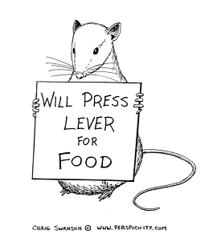
Reinforcement Learning
Anton Kabysh
Brest State Technical University

Slide 2
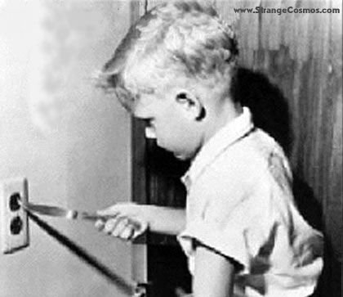
RL in one slide

Slide 3
RL in one slide
… learning from trial-and-error and reward by interaction with an environment.

Slide 4
RL elements
Anton Kabysh
Brest State Technical University

Slide 5
Basic Elements: Agent
Agent – everything that can sense environment ant act in it.
Autonomous – select actions by themself using only (1) current information and (2) past experience.

Slide 6
Basic Elements: Agent
Agent – everything that can sense environment ant act in it.
Autonomous – select actions by themself using only (1) current information and (2) past experience.
Rational – select actions in some way that optimize some metric or value.

Slide 7
Basic Elements: Agent
Agent – everything that can sense environment ant act in it.
Autonomous – select actions by themself using only (1) current information and (2) past experience.
Rational – select actions in some way that optimize some metric or value.
Intelligent – if agent change it’s own behavior during time using past experience to be a more rational.

Slide 8

Basic Elements: Agent Behavior
Sense-Act-Loop – basic agent behavior.
Sense (Perceive) the environment – current state $s_{t}$
Act in the environment – current action $a_{t}$

Slide 9
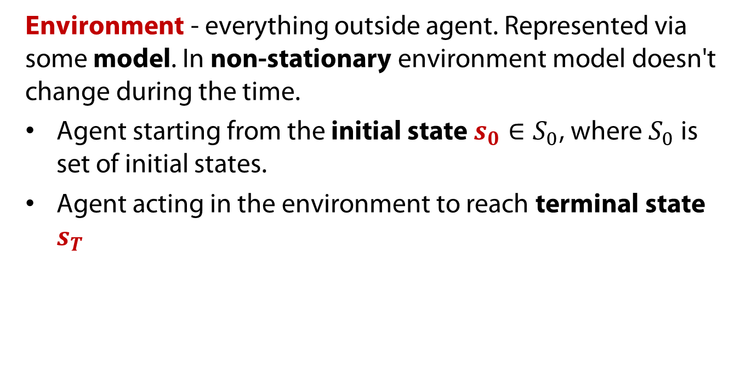
Basic Elements: Environment
Environment - everything outside agent. Represented via some model. In non-stationary environment model doesn't change during the time.
Agent starting from the initial state $s_{0}∈S_{0}$, where $S_{0}$ is set of initial states.
Agent acting in the environment to reach terminal state $s_{T}$

Slide 10
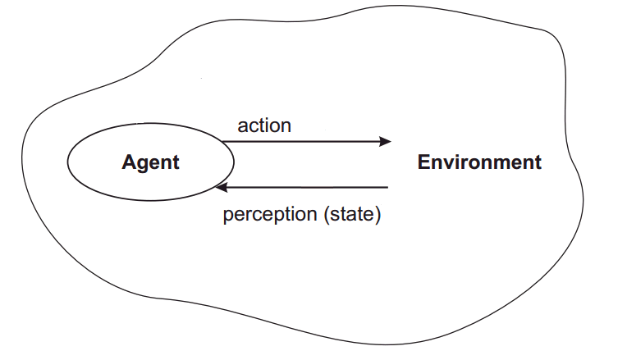


General Model: AI Perspective
$$a_{t}$$
$$s_{t}$$

Slide 11
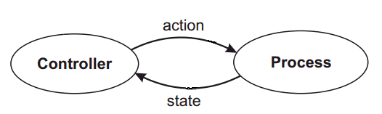


General Model: Control Perspective
$$a_{t}$$
$$s_{t}$$

Slide 12
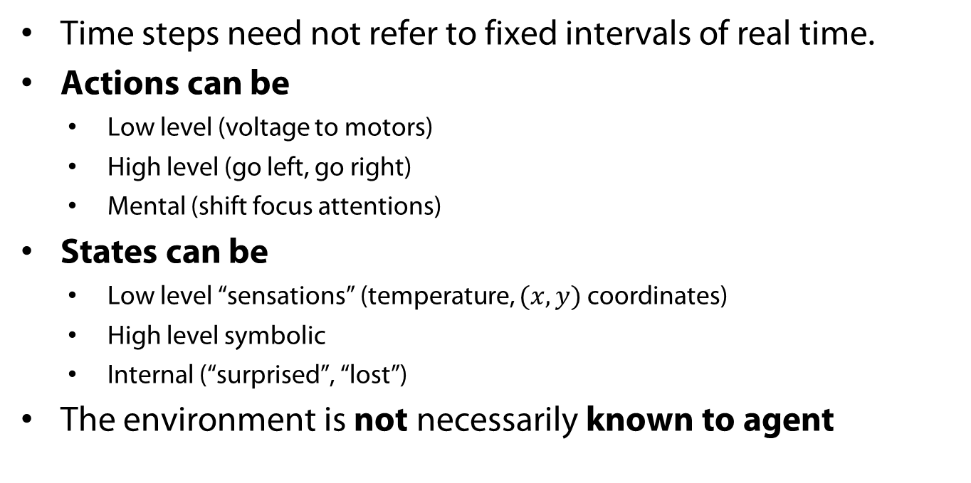
Elements of RL
  Time steps need not refer to fixed intervals of real time.
  Actions can be
    Low level (voltage to motors)
    High level (go left, go right)
    Mental (shift focus attentions)
  States can be
    Low level “sensations” (temperature, $(x,y)$ coordinates)
    High level symbolic
    Internal (“surprised”, “lost”)
  The environment is not necessarily known to agent

Slide 13
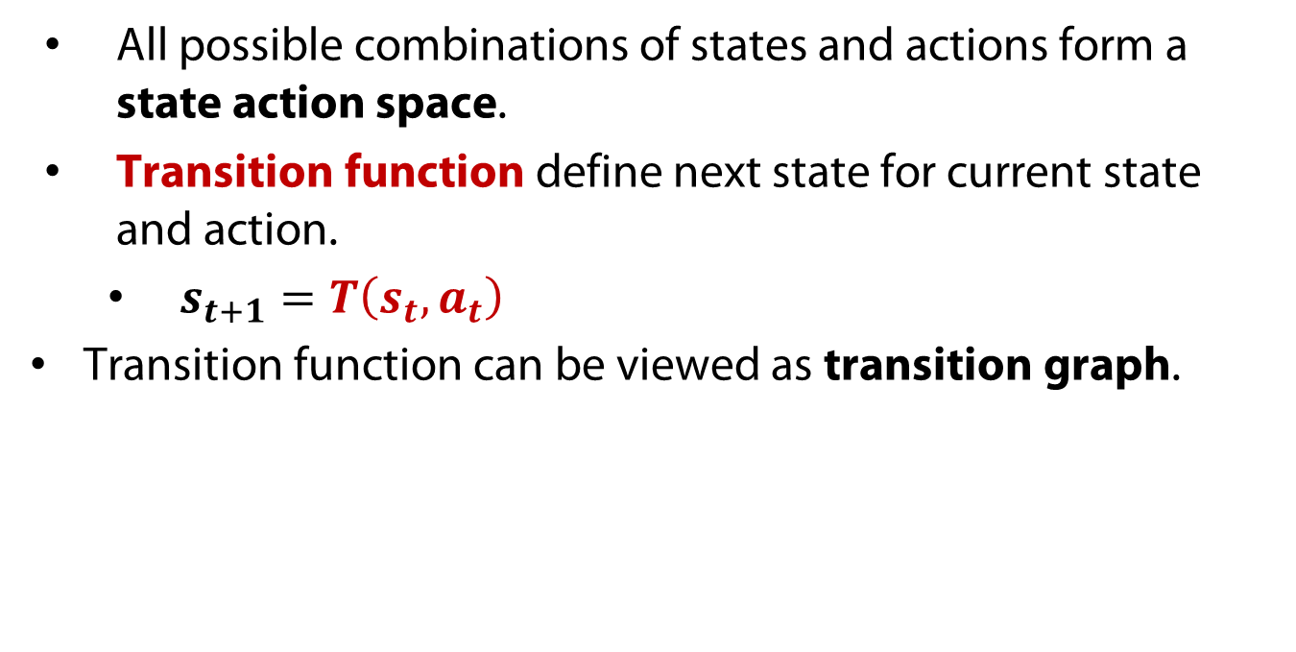
State-Action space
All possible combinations of states and actions form a state action space.
Transition function define next state for current state and action.
  $s_{t+1}=T\left(s_{t},a_{t}\right)$
  Transition function can be viewed as transition graph.

Slide 14

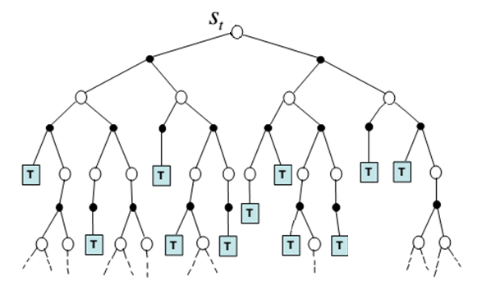
Transition graph

Slide 15
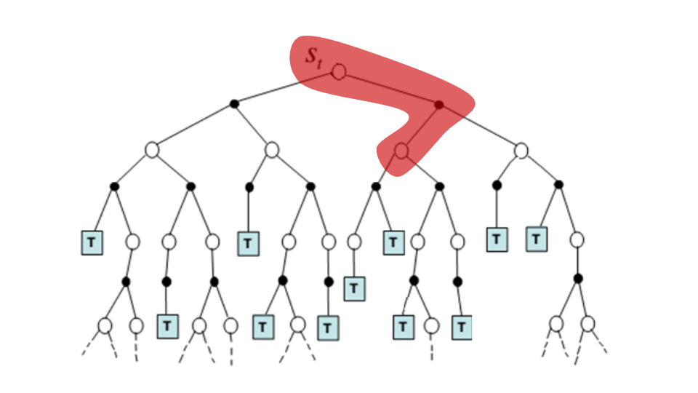



Transition
$$s_{t}\underset{→}{a_{t}}s_{t+1}$$
$$a_{t}$$
$$s_{t+1}$$

Slide 16

Sequential Decision Making
Sequential decision making – task, when agent should find a [optimal] set of actions $a=(a_{1},a_{2},…,a_{T})$that put it from initial state $s_{0}$ terminal state $s_{T}$.

Slide 17

Agent policy
  The agent policy $π$ at time $t$ is a mapping from state to action - ${a_{t}=π}_{t}\left(s_{t}\right)$.
  Agent select actions using current policy.
  The sequential decision problem can be implemented into agent policy.

Slide 18



General Model: AI Perspective
$$a_{t}$$
$$s_{t+1}=T(s_{t},a_{t})$$
${a_{t}=π}_{t}\left(s_{t}\right)$
$$s_{t}$$

Slide 19


General Model: Control Perspective
$$a_{t}$$
$$s_{t}$$
${a_{t}=π}_{t}\left(s_{t}\right)$
$$s_{t+1}=T(s_{t},a_{t})$$

Slide 20
Sequential Decision Making
  How to solve sequential decision making problem:
  Program set of policies directly.
  Planning and Search algorithms to create a plan if we know the model.
  Learning – to learn model.
    Supervised – provide etalon actions
    Unsupervised – provide nothing
    RL – provide evaluative feedback

Slide 21
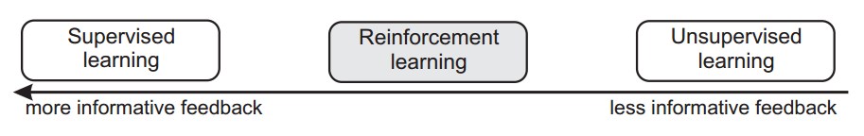
Evaluative Feedback
Evaluative feedback – any numerical value, received as feedback, reflecting how good action was, but does not indicate how much it is close to optimal (or worst).

Slide 22
Evaluative Feedback
[Positive] Reinforcement – any stimuli, event or signal that increase the probability of selecting actions that lead to reinforced stimuli, events or signals (Skinner).

Slide 23
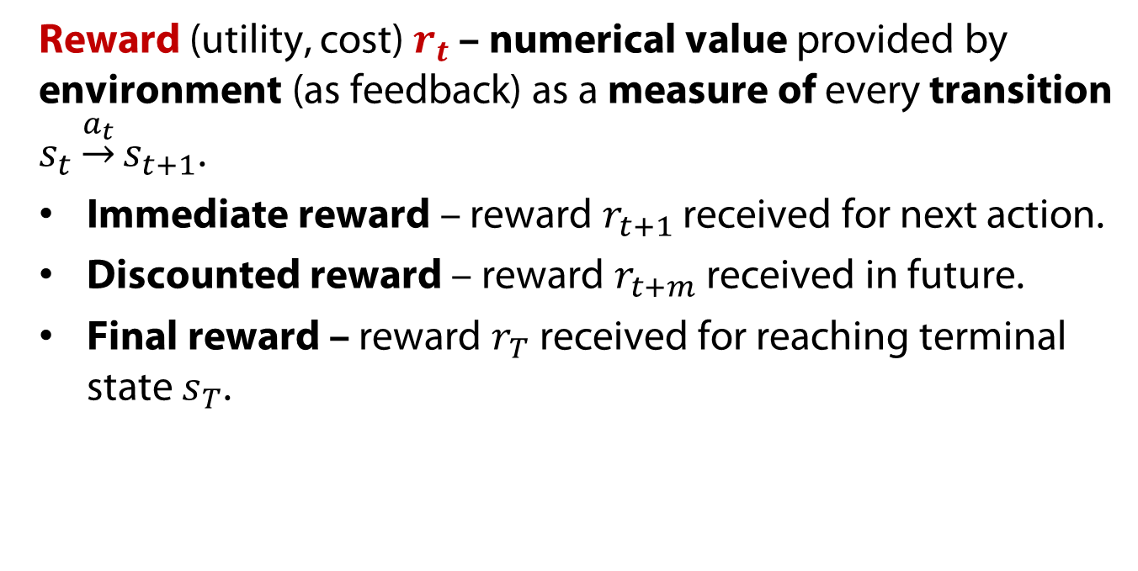
Evaluative Feedback
Reward (utility, cost) $r_{t}$ – numerical value provided by environment (as feedback) as a measure of every transition $s_{t}\underset{→}{a_{t}}s_{t+1}$.
Immediate reward – reward $r_{t+1}$ received for next action.
Discounted reward – reward $r_{t+m}$ received in future.
Final reward – reward $r_{T}$ received for reaching terminal state $s_{T}$.

Slide 24
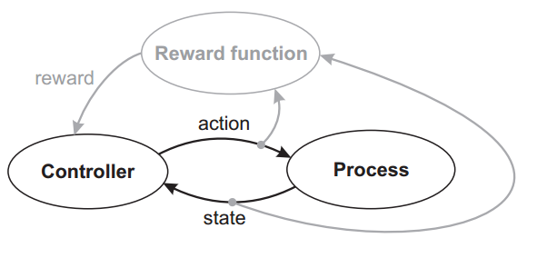






General Model: Control Perspective
$R(s_{t},a_{t})$
$$r_{t+1}$$
$$a_{t}$$
$$s_{t}$$
$π_{t}\left(s_{t}\right)$
$$s_{t+1}=T(s_{t},a_{t})$$

Slide 25
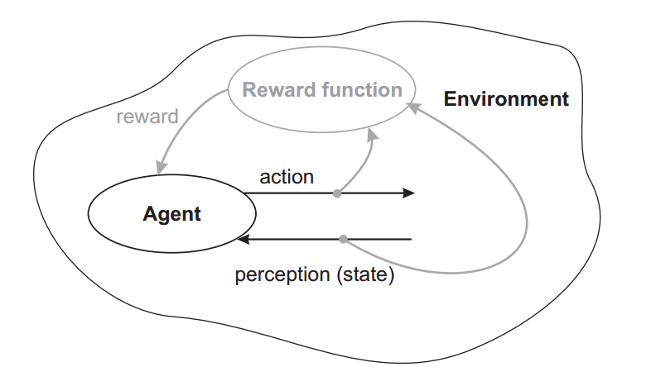





General Model: AI Perspective
$R(s_{t},a_{t})$
$$r_{t+1}$$
$$a_{t}$$
$π_{t}\left(s_{t}\right)$
$$s_{t}$$

Slide 26


Transition
$$s_{t}\underset{→}{a_{t}}{r_{t+1}, s}_{t+1}$$
$$a_{t}$$
$$s_{t+1}$$
$$r_{t+1}$$

Slide 27

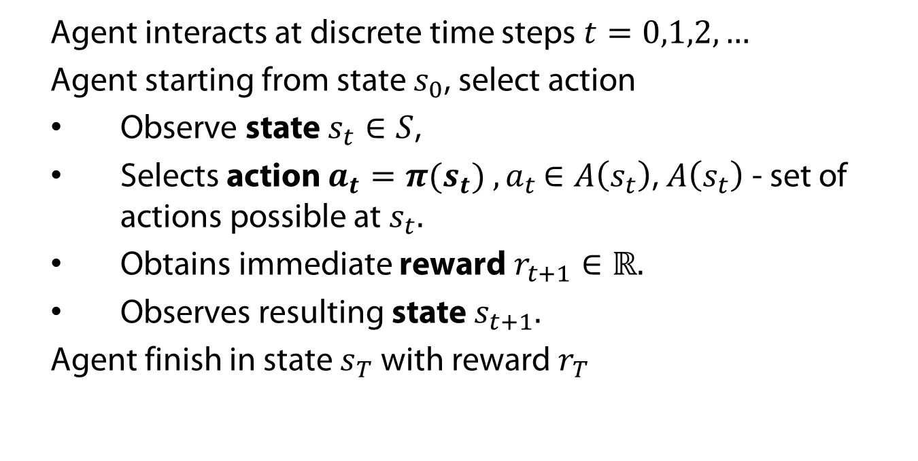
State-Action-Reward-State
    Agent interacts at discrete time steps $t=0,1,2,…$
    Agent starting from state $s_{0}$, select action
    Observe state $s_{t}∈S$,
    Selects action $a_{t}=π(s_{t})$ ${,a}_{t}∈A\left(s_{t}\right)$, $A\left(s_{t}\right)$ - set of actions possible at $s_{t}.$
    Obtains immediate reward $r_{t+1}∈ℝ.$
    Observes resulting state $s_{t+1}.$
    Agent finish in state $s_{T}$ with reward $r_{T}$
…
…

Slide 28
RL Goal
  Reward function + Transition function = Model. Model is typically doesnt known for agent.
  The goal of learning algorithm is to find appropriate policy on the model.
  Reinforcement learning algorithm – is any algorithm that uses only reward signal to find a policy.

Slide 29
RL Task
  Reinforcement learning task is a combination of agent, environment, model and reinforcement learning algorithm with settings of some external parameters.
    Episodic (Finite task) task
    Indefinite task
    Infinite (Infinite) task

Slide 30
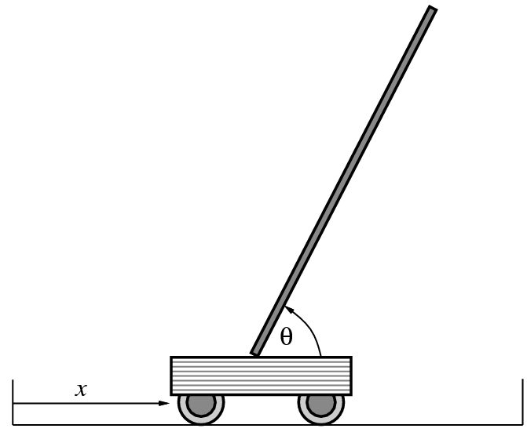
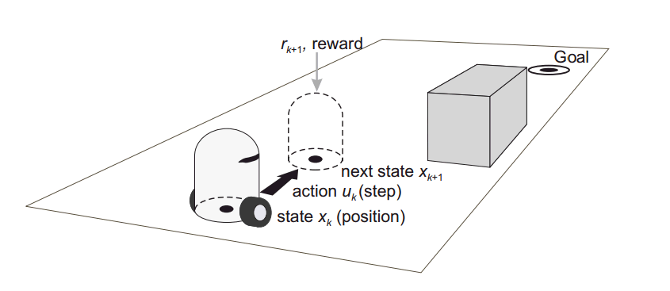
RL Task
    Episodic (Finite task) task
    Infinite task

Slide 31

Return
  Consider a sequence of transitions…
  Return – the cumulative reward over the course of interaction:
$$R=r_{0}+r_{1}+r_{t+1}+r_{t+2}+…+$$

Slide 32
The goal:
  The goal is to maximize the long term return, consisting of the cumulative reward over the course of interaction.
$$R=r_{0}+r_{1}+r_{t+1}+r_{t+2}+…+r_{T} →max$$

Slide 33

The more general goal:
  Starting from current state $s_{t}$, the goal is to maximize the return, consisting of :
$R_{t}=r_{t+1}+r_{t+2}+…+r_{T}$ $→\max{}$

Slide 34
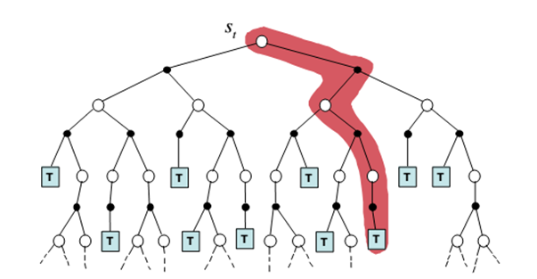

Return
$$R_{t}=r_{t+1}+r_{t+2}+r_{T}$$

Slide 35

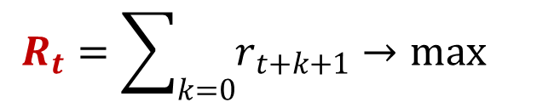
Return for finite horizon
  If learning is finite horizon task we use sum of future rewards.
  Task is finite $→$ sum is finite
$$R_{t}=\sum_{k=0}{r_{t+k+1}}→\max{}$$

Slide 36

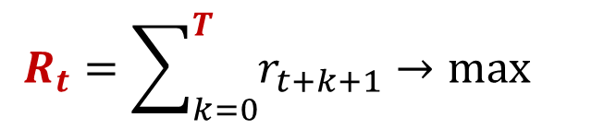
Return for finite horizon
  If learning is finite horizon task we use finite horizon reward in horizon $T$:
  Task is finite & Horizon is finite $→$ Sum is finite
$$R_{t}=\sum_{k=0}^{T}{r_{t+k+1}}→\max{}$$

Slide 37


Return for infinite horizon
  If learning is infinite (indefinite) horizon task situation is more complicated: sum of future rewards goes to infinity.
    Task is infinite $→$ Sum is infinite
$$R_{t}=r_{t+1}+r_{t+2}+…+r_{∞}→∞$$

Slide 38

Return for infinite horizon
  If learning is infinite (indefinite) we can use finite horizon reward in horizon $T$:
  Task is infinite & Horizon is finite $→$ Sum is finite
$$R_{t}=\sum_{k=0}^{T}{r_{t+k+1}}→\max{}$$

Slide 39
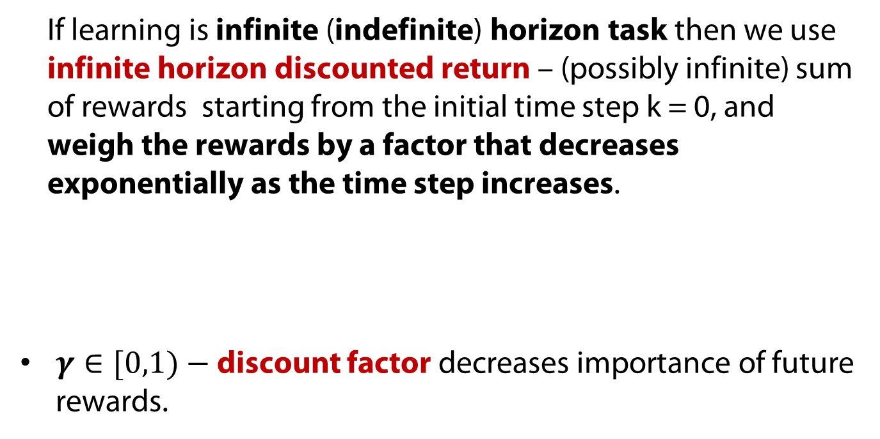
Infinite task discount return
  If learning is infinite (indefinite) horizon task then we use infinite horizon discounted return – (possibly infinite) sum of rewards starting from the initial time step k = 0, and weigh the rewards by a factor that decreases exponentially as the time step increases.
  $γ∈[0,1)−$ discount factor decreases importance of future rewards.
$$R_{t}=r_{t+1}+γr_{t+2}+γ^{2}r_{t+3}+γ^{3}r_{t+4}+…$$

Slide 40
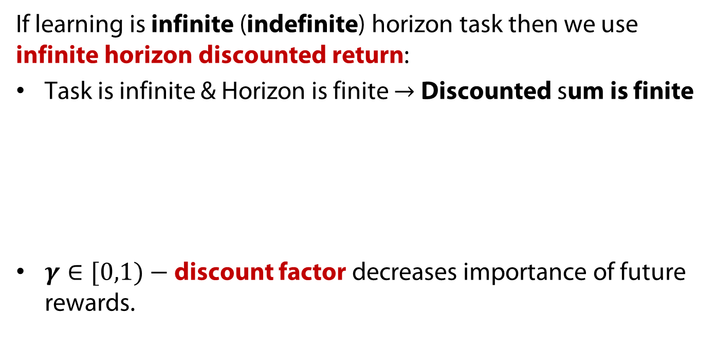
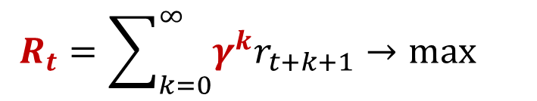
Infinite task discount return
  If learning is infinite (indefinite) horizon task then we use infinite horizon discounted return:
  Task is infinite & Horizon is finite $→$ Discounted sum is finite
  $γ∈[0,1)−$ discount factor decreases importance of future rewards.
$$R_{t}=\sum_{k=0}^{∞}{{γ^{k}r}_{t+k+1}→\max{}}$$

Slide 41
Robotics Navigation Example

Slide 42
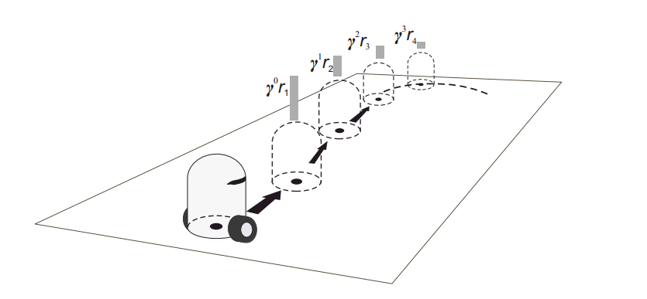
Robotics Navigation Example
Reinforcement Learning

Slide 43

Expected Return
  Starting from current state $s_{t}$ there are a lot of possible trajectories.

Slide 44
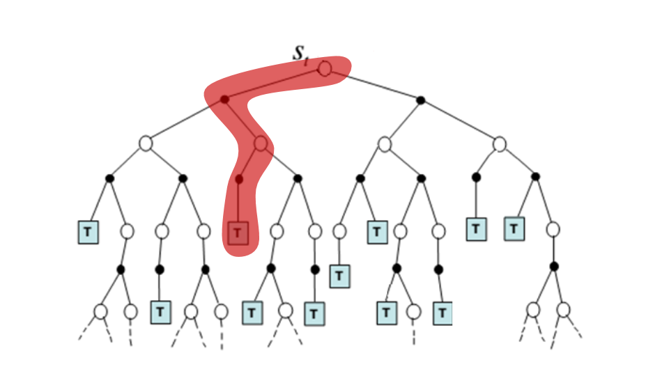

Episode 1
$$R_{1}$$

Slide 45
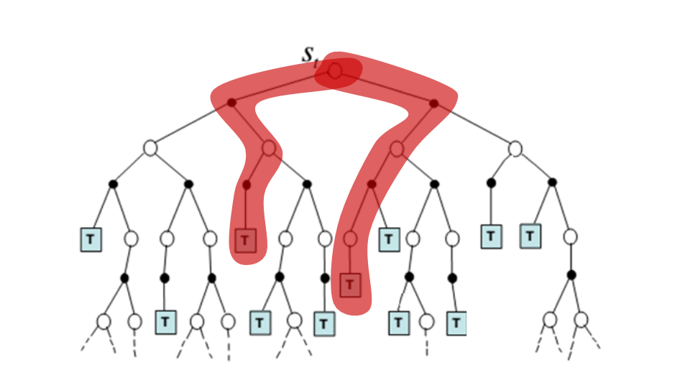


Episode 2
$$R_{1}$$
$$R_{2}$$

Slide 46
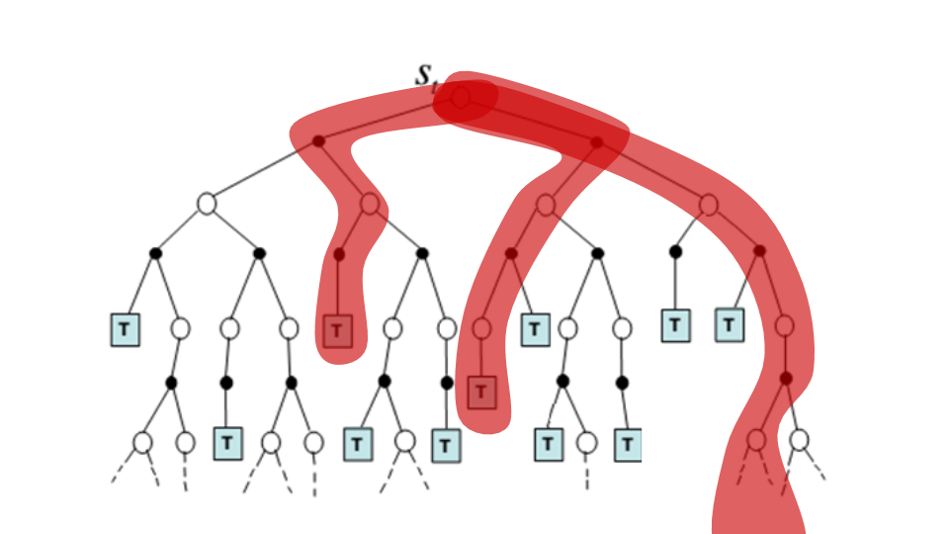

Expected Return
$$R_{1}$$
$$R_{2}$$
$$R_{3}$$

Slide 47
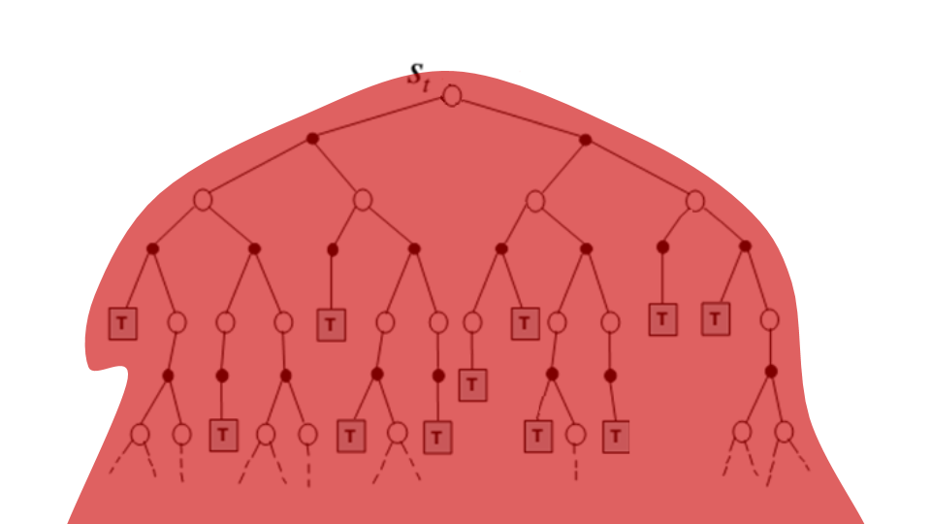

Episode (n)
  $$R=[R_{1},R_{2},…{,R}_{n}]$$

Slide 48

Episode (n)
  $$R=\frac{1}{n}\sum_{i}{R_{i}}$$

Slide 49
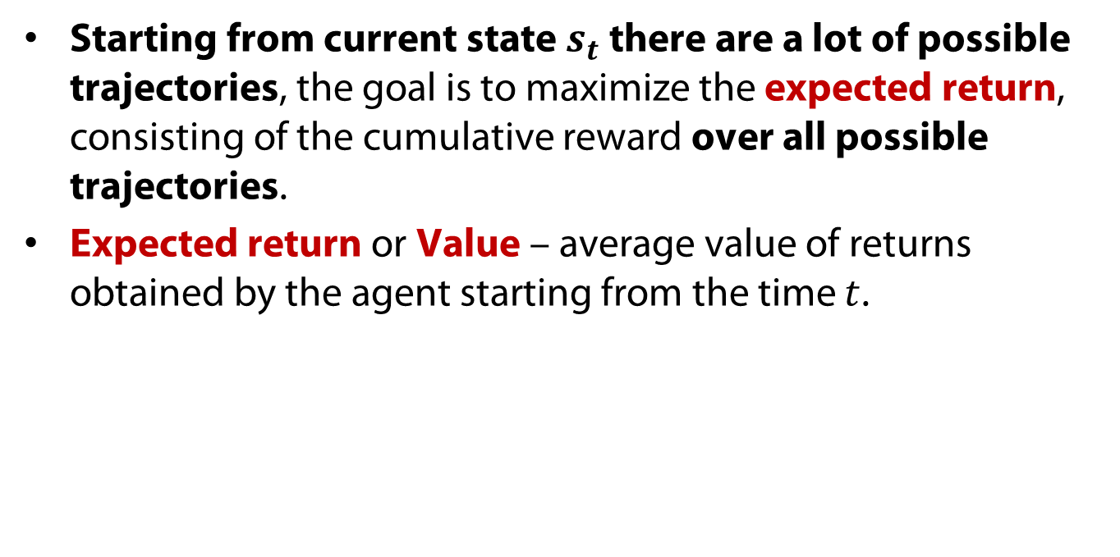

Expected Return
  Starting from current state $s_{t}$ there are a lot of possible trajectories, the goal is to maximize the expected return, consisting of the cumulative reward over all possible trajectories.
  Expected return or Value – average value of returns obtained by the agent starting from the time $t$.
$E\{R_{t}\}$ $→\max{}$

Slide 50


Expected Return
  Starting from current state $s_{t}$, the goal is find a optimal policy $π^{∗}$ that maximize the expected return, consisting of the cumulative reward under this policy.
$E_{π}\{R_{t}\}$ $→\max{}$

Slide 51
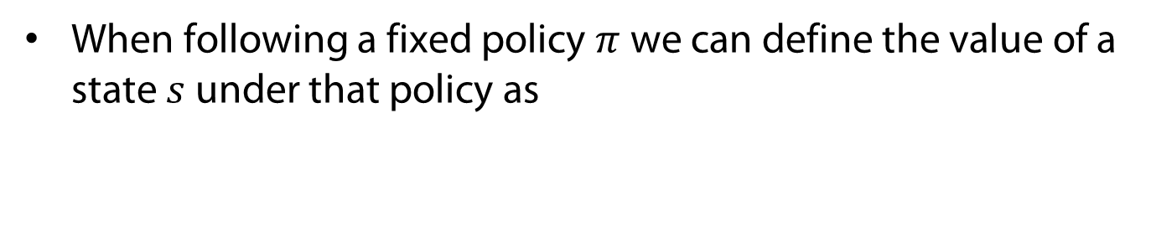

State Value Function
  When following a fixed policy $π$ we can define the value of a state $s$ under that policy as
$$V^{π}\left(s\right)=E_{π}\left\{R_{t} | s=s_{t}\right\}$$

Slide 52
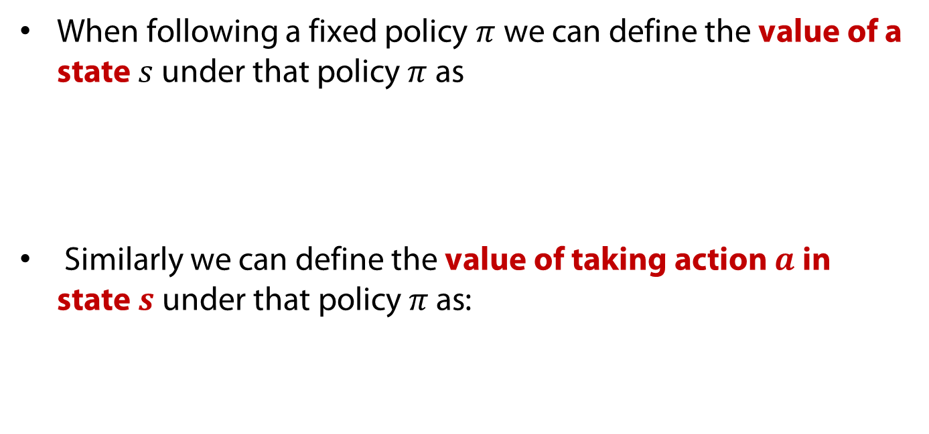

Action Value Function
  When following a fixed policy $π$ we can define the value of a state $s$ under that policy $π$ as
  Similarly we can define the value of taking action $a$ in state $s \text{under} \text{that} \text{policy} π \text{as}$:
$$V^{π}\left(s\right)=E_{π}\left\{R_{t} | s=s_{t}\right\}$$
$$Q^{π}\left(s,a\right)=E_{π}\left\{R_{t} | s=s_{t}, a=a_{t}\right\}$$

Slide 53

Value Functions
State value function - the expected sum of discounted reward for following the policy $π$ from state $s_{t}$ to the end of time.
State-action value function - the expected sum of discounted reward for starting in state $s_{t}$, taking action $a_{t}$ once then following the policy $π$ from state $s_{t+1}$ to the end of time.

Slide 54
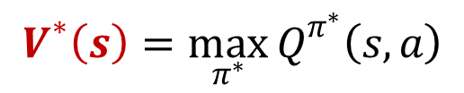
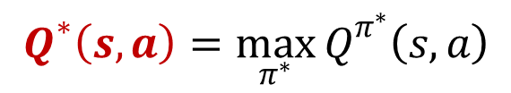
Optimal Value Functions
  We want to find a policy that maximizes long term expected reward, which evaluates to finding the optimal VF:
$$V^{∗}\left(s\right)=\max_{π^{∗}}{Q^{π^{∗}}\left(s,a\right)}$$
$$Q^{∗}\left(s,a\right)=\max_{π^{∗}}{Q^{π^{∗}}\left(s,a\right)}$$

Slide 55

Markov Property
  It is often useful to assume that all relevant information is present in the current state: Markov Property.
$${h_{t}=(s}_{0},a_{0},s_{1},a_{1},…,a_{t−1},s_{t})$$
$$\operatorname{Pr}\left(s_{t+1} | h_{t}\right)=\operatorname{Pr}\left(s_{t+1} | s_{t},a_{t}\right)=T(s_{t},a_{t},s_{t+1})$$

Slide 56
Markov Property
  It is often useful to assume that all relevant information is present in the current state: Markov Property.
  If reinforcement learning task has the Markov Property is basically described by the Markov Decision Process.
$${h_{t}=(s}_{0},a_{0},s_{1},a_{1},…,a_{t−1},s_{t})$$
$$\operatorname{Pr}\left(s_{t+1} | h_{t}\right)=\operatorname{Pr}\left(s_{t+1} | s_{t},a_{t}\right)=T(s_{t},a_{t},s_{t+1})$$

Slide 57
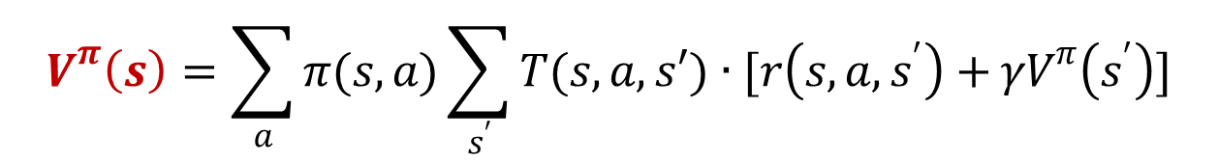
Bellman equation
  The value function has a particular recursive relationship, defined by the Bellman equation.
  We can find optimal policy by solving Bellman equation.
$$V^{π}\left(s\right)=\sum_{a}{π(s,a)\sum_{s^{′}}{T(s,a,s′)∙[r\left(s,a,s^{′}\right)+}γV^{π}\left(s^{′}\right)]}$$

Slide 58

Solution
  Solve RL problem – it is a find optimal policy $π^{∗}$ on MDP using some of RL-algorithm.

Slide 59
Approaches to RL
Policy search
Model-based RL
Model-free RL
Active Learning (Off-Policy Learning)
Passive Learning (On-Policy learning)

Slide 60
Bellman equation

Slide 61
Properties of RL
Learner is not told which actions to take
Trial-and-Error search
Possibility of delayed reward (sacrifice short-term gains for greater long-term gains)
The need to explore and exploit
Considers the whole problem of a goal-directed agent interacting with an uncertain environment

Slide 62
Conclusion
RL is not a some magic method or set of algorithms. This is general framework. This is more “formulation of the problem”.
If you can see necessary components of RL, you can apply any RL approach.
  Agent (Controller) who can act
  Environment (Process) with states which agent try to control by actions.
  Agent receive evaluative feedback via reward values.
  The goal is to find optimal control policy.

Slide 63
RL and other sciences
Artificial Intelligence
Control Theory and
Operations Research
Psychology
Reinforcement
Learning (RL)
Neuroscience
Artificial Neural Networks

Slide 64
Overview over different methods – Reinforcement Learning

Slide 65
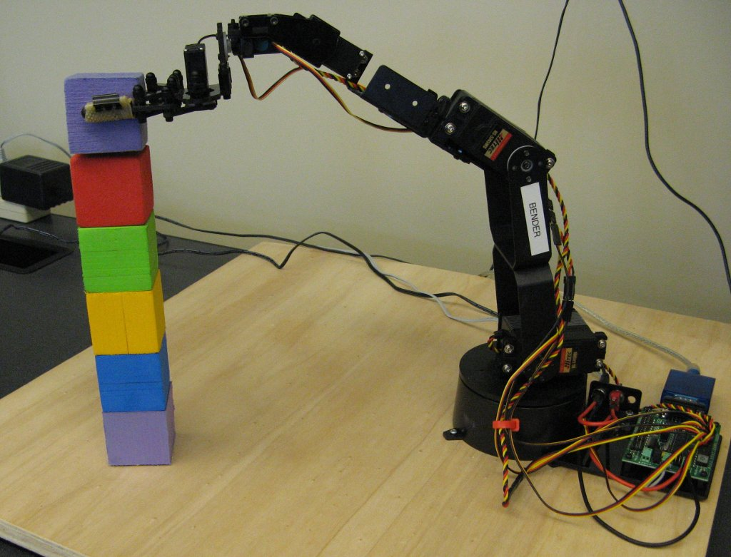
RL for robotics
Anton Kabysh
Brest State Technical University

Slide 66
Learning of a Stand-up Behavior
Learning to stand-up with a 3-linked planar robot.
6-D state space
  Angles + Velocities
Hierarchical Reinforcement Learning
  Task decomposition by Sub-goals
  Decompose task into:
    Non–linear problem in a lower dimensional space
    Nearly-linear problem in a high-dimensional space

Slide 67
Upper-level Learning
Coarse Discretization of postures
  No speed information in the state space (3-d state space):
Actions: Select sub-goals
  New Sub-goal

Slide 68
Upper-Level Learning
Reward Function:
  Reward success of stand-up
  Reward also for the success of a subgoal
  Choosing sub-goals which are easier to reach from the current state is prefered
Use Q(lambda) learning to learn the sequence of sub-goals

Slide 69
Dynamic Programming for Biped Locomotion
4-link planar robot
Dynamic Programming for Reduced Dimensional Spaces

Slide 70

State-Increment Dynamic Programming
8-dimensional state space:
Discretize State-Space by coarse grid
Use Dynamic Programming:
  Interval ε is defined as the minimum time intervall required for any state index to change

Slide 71
Autonomous Helicopter Flight
Autonomously learn to fly an unmanned helicopter
  70000 $ => Catastrophic Exploration!
Learn Dynamics from the observation of a Human pilot
Use PEGASUS to:
  Learn to Hover
  Learn to fly complex maneuvers
  Inverted Helicopter flight

Slide 72
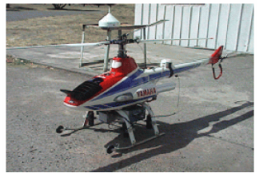
Helicopter Flight: Model Indenfication
12 dimensional state space
  World Coordinates (Position + Rotation) + Velocities
4-dimensional actions
  2 rotor-plane pitch
  Rotor blade tilt
  Tail rotor tilt
Actions are selected every 20 ms

Slide 73
Helicopter Flight: Hover Control
Results: Better performance than Human Expert (red)

